Slide 1
Bank Management System
Presented By
Manali Bhosale

Slide 2
Aim:
To developed a software for solving financial application of a customer in banking environment in order to the need of an end banking user by providing various way to perform banking task . Also to enable to have additional functionalities which are provided under a conventional banking software.

Slide 3
Hardware and Software Requirements:
Software Requirements:
XAMPP
Visual Studio Code
Any Browser
FRONT END
PHP
HTML
Hardware Requirements:
Computer or Laptop
Ram : 520KB
BACK END
MYSQL(DataBase)

Slide 4
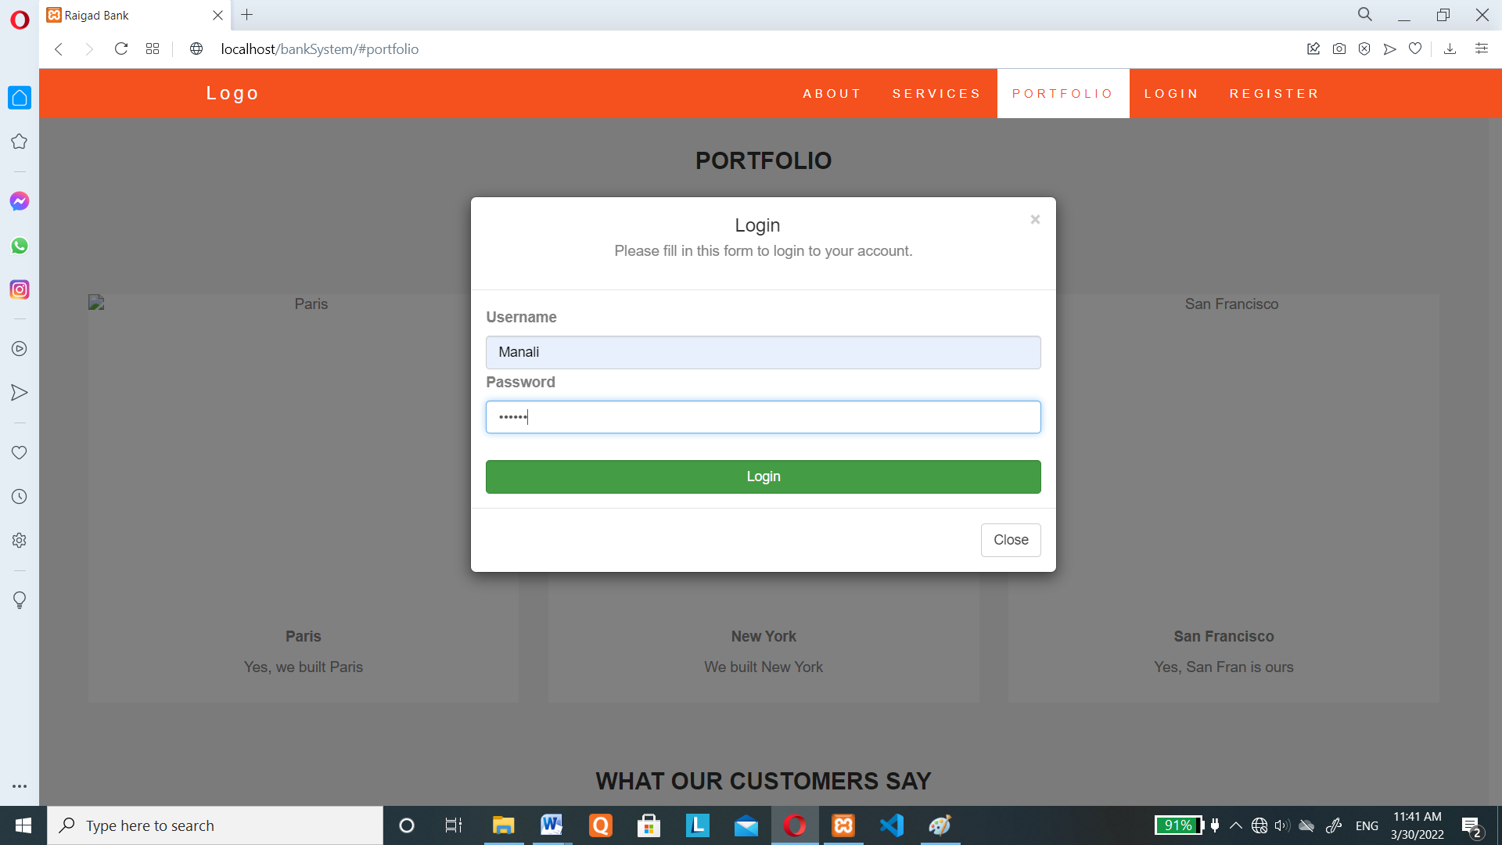
Login Page:

Slide 5
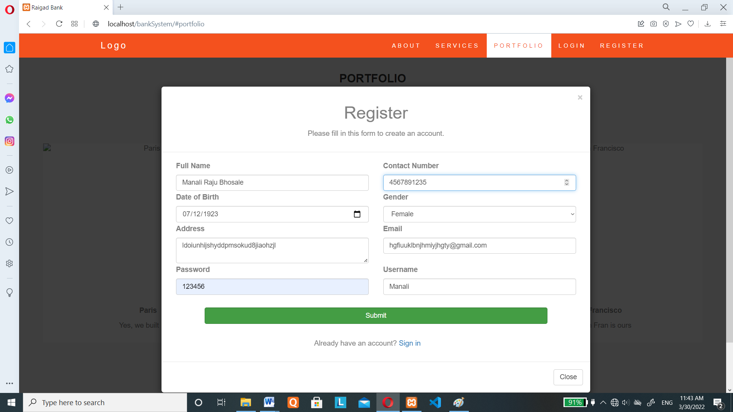
Registration Page:

Slide 6
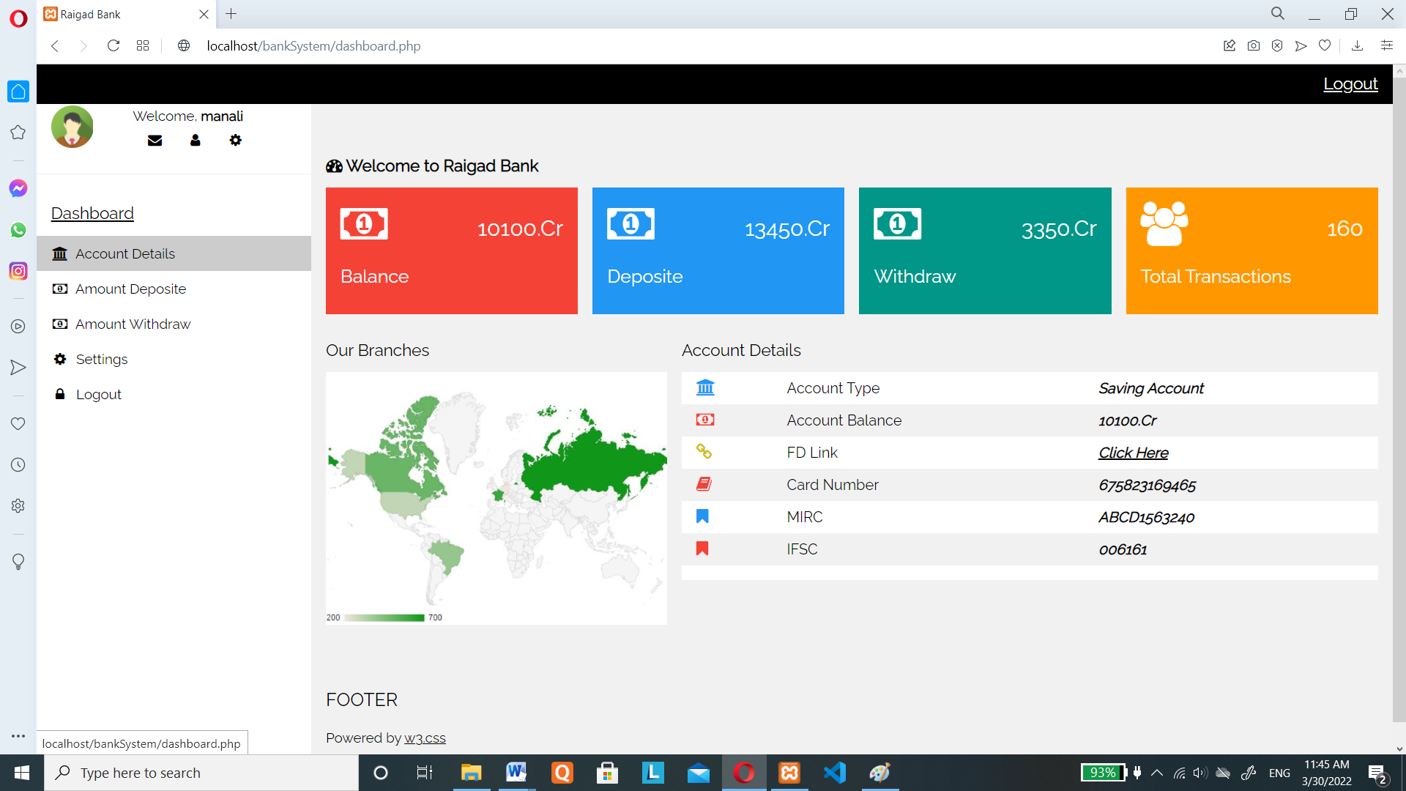
Account Details :

Slide 7
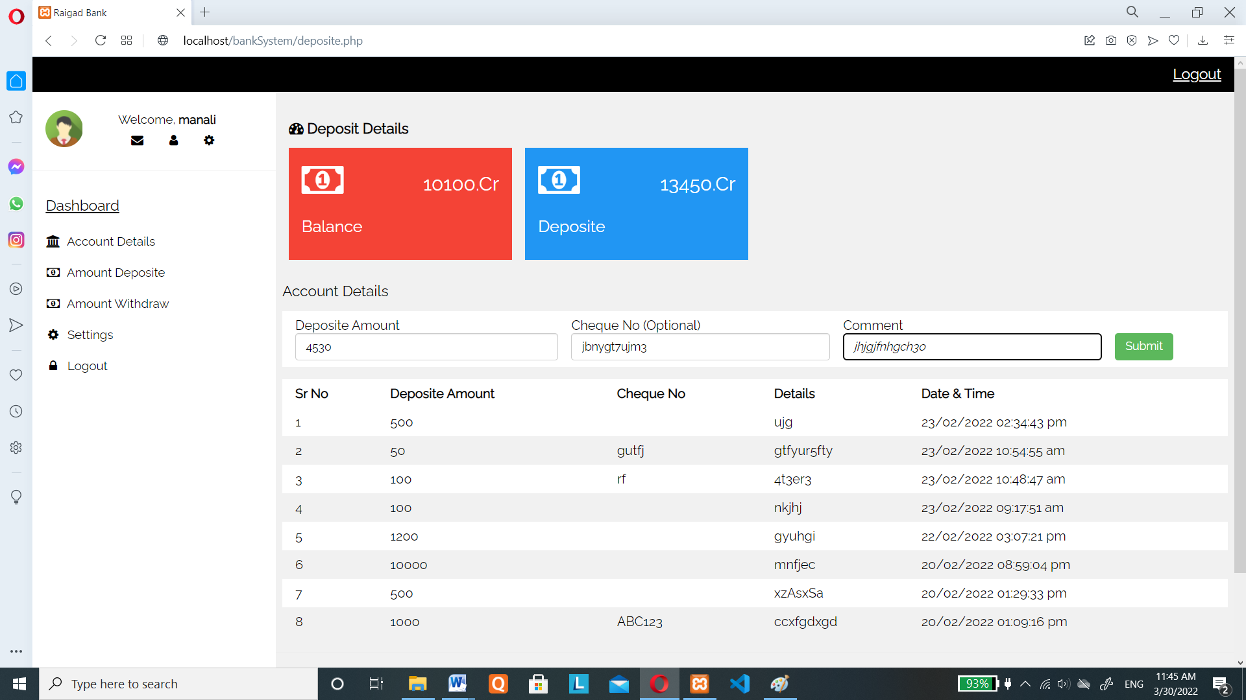
Amount Deposit:

Slide 8
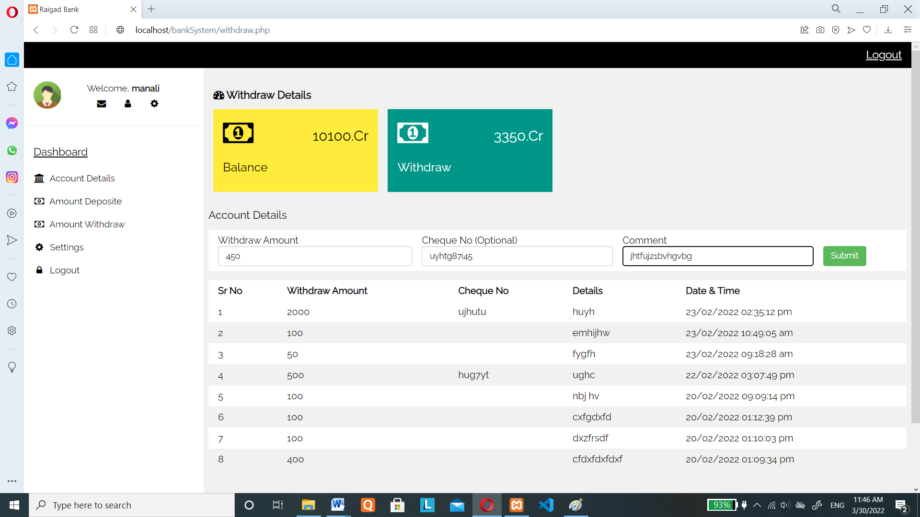
Amount Withdraw:

Slide 9
Thank You…..

